Slide 1
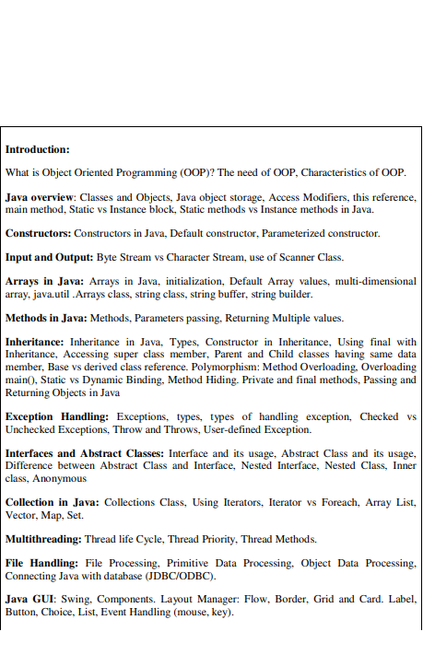

Slide 2
JDBC

Slide 3
Introduction-JDBC
JDBC is a Sun trademark
  Java Database Connectivity (JDBC) is a standard Java API to interact with relational databases from Java.
JDBC is a means of accessing SQL databases from Java
  JDBC is also a specification for how third-party vendors should write database drivers to access specific SQL versions

Slide 4
The Structured Query Language (SQL)
Composed of two categories:
  Data Manipulation Language (DML)
    (DML) statements are used for managing data within schema objects.
    e.g.
      select
      delete
      update
  Data Definition Language (DDL)
    (DDL) statements are used to define the database structure or schema
    e.g.
      create database
      create table
      drop database

Slide 5
Data Manipulation Language
SELECT - query the database
  select * from customer where id > 1001
INSERT - adds new rows to a table.
  Insert into customer values (1009, ‘ABC’)
DELTE - removes a specified row
  delete
UPDATE - modifies an existing row
  update customers set amount = 10 where id > 1003

Slide 6
Data Definition Language
CREATE DATABASE - allows you to create a database
CREATE TABLE - allows you to create a table definition in a database
DROP TABLE - removes a table from a database
ALTER TABLE - modifies the definition of a table in a database

Slide 7
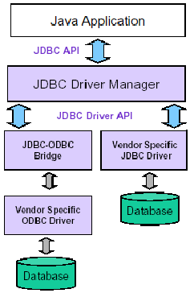
JDBC Architecture
consists of two layers:
  JDBC API, which provides the application-to-JDBC Manager connection.
  The JDBC Driver API, which supports the JDBC Manager-to-Driver Connection.

Slide 8
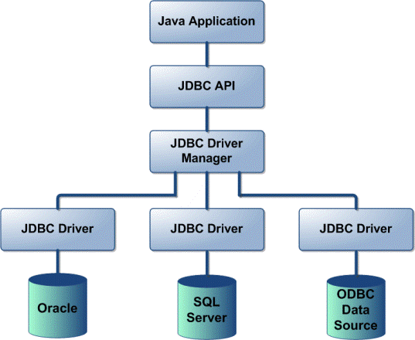
JDBC Architecture
The JDBC API uses a driver manager and database-specific drivers to provide transparent connectivity to heterogeneous databases.
The driver manager is capable of supporting multiple concurrent drivers connected to multiple heterogeneous databases.

Slide 9
Main Components of JDBC
DriverManager: Manages a list of database drivers. Matches connection requests from the java application with the proper database driver using communication subprotocol.
Driver: The database communications link, handling all communication with the database. Normally, once the driver is loaded, the developer need not call it explicitly.
Connection : Interface with all methods for contacting a database. The connection object represents communication context, i.e., all communication with database is through connection object only.
Statement : Encapsulates an SQL statement which is passed to the database to be parsed, compiled, planned and executed.
ResultSet: The ResultSet represents set of rows retrieved due to query execution.

Slide 10
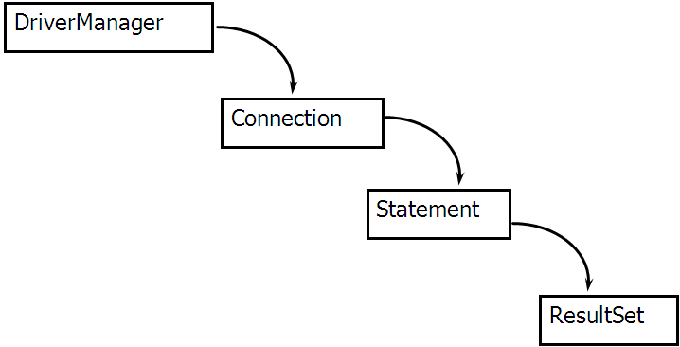
JDBC Class Usage
Four primary classes of java.sql Package used to
  load a driver
      (java.sql.DriverManager)
  connect to the DB
      (java.sql.Connection)
  create a SQL statement
      (java.sql.Statement)
  execute a SQL statement
      (java.sql.ResultSet)

Slide 11
Driver Manager Object
Loads the proper driver into your java object
  multiple drivers may be loaded to allow connections to multiple databases
Provides a common interface to RDBMSs for JDBC Drivers
JAVA Application
Driver Manager
Driver ‘A’
Driver ‘B’
Connection
Connection
Statement
Statement
Result Set
Result Set

Slide 12
Driver Manager Class Methods
getConnection(url,”username”,”password”)
getDriver
registerDriver
deregisterDriver
getDrivers
setLoginTimeout
getLoginTimeout
setLogStream
getLogStream

Slide 13
Connection Object
Establish link between the JAVA application and RDBMS
allows application to select proper driver when it needs to
uses the database URL to make the connection
  jdbc:<subprotocol>:<subname>
  e.g.
    jdbc:odbc:Mydatabase
    jdbc:derby://localhost:1527/hello

Slide 14
Connection Class Methods
createStatement
prepareStatement
prepareCall
NativeSQL
setAutoCommit
GetAutoCommit
commit
rollback
close
isclosed

Slide 15
Statement Object
Wrapper of a string containing a SQL statement
allows JDBC to decompose the SQL into a set of steps to present to the database via the driver
the connection object forwards the statement object to the database to obtain a results set object

Slide 16
Statement Class Methods
executeQuery
executeUpdate
  insert, update, delete
close
getResultSet

Slide 17
ResultSet Object
A container for the rows and columns (a table) acquired as a result of presenting a statement object to the RDBMs using the “executeQuery” statement method

Slide 18
ResultSet Class Methods
next
close
wasNull
getString
getBoolean
getByte
getShort
getInt
getLong
getFloat
getDouble
getNumeric
getBytes
getDate
getTime
getTimeStamp
getAsciiStream
getUnicodeStream
getBinaryStream
getMetaData
etc...

Slide 19
Basic Steps in writing a Java program using JDBC
Load the RDBMS specific JDBC Driver (Incase of JDBC 4.0 this is automatically loaded)
Open the connection to database which is then used to send SQL statements and get results back.
Create JDBC Statement object. This object contains SQL query
Execute statement which returns resultset(s). ResultSet contains the tuples of database table as a result of SQL query.
Process the resultset
Close the Connection

Slide 20
JDBC: Details of Process
Load the driver
try {
Class.forName("org.apache.derby.jdbc.ClientDriver ");
Class.forName("com.mysql.jdbc.Driver");
} catch { ClassNotFoundException cnfe) {
System.out.println("Error loading driver: " cnfe);
}
Open the connection to database
String host = “localhost";
String dbName = “hello";
int port = 1527;
String derbyURL = "jdbc:derby://localhost:1527/hello";
String mysqlURL = "jdbc:mysql://" + host +
":" + port + "/" + dbName;

Slide 21
JDBC: Details of Process, cont.
Establish the Connection
String username = “nbuser";
String password = “nbuser";
Connection con =
DriverManager.getConnection(derbyURL,username,password);
Optionally, get information about the db system
DatabaseMetaData dbMetaData = connection.getMetaData();
String productName =
dbMetaData.getDatabaseProductName();
System.out.println("Database: " + productName);
String productVersion =
dbMetaData.getDatabaseProductVersion();
System.out.println("Version: " + productVersion);

Slide 22
JDBC: Details of Process, cont.
3. Create JDBC Statement object
Statement statement = con.createStatement();
4. Execute a Query
String query = "select * from NBUSER.CONTACTS"; ResultSet resultSet = statement.executeQuery(query);
  To modify the database, use executeUpdate, supplying a string that uses UPDATE, INSERT, or DELETE

Slide 23
JDBC: Details of Process, cont.
5. Process the Resultset
while(resultSet.next()) {
System.out.println(resultSet.getString(1) + " " +
resultSet.getString(2) + " " +
resultSet.getString(3));
}
  First column has index 1, not 0
  ResultSet provides various get... methods that take a column index or name and returns the data
6. Close the Connection
con.close();
  As opening a connection is expensive, postpone this step if additional database operations are expected

Slide 24
Example 1: Basic JDBC Example
import java.sql.*;
public class TestDriver {
public static void main(String[] Args) {
try { Class.forName("com.mysql.jdbc.Driver").newInstance();}
catch (Exception E) {
System.err.println("Unable to load driver.");
E.printStackTrace();
}
try {
Connection C = DriverManager.getConnection(
"jdbc:mysql://almaak.usc.edu:3307/menagerie",
"root", "xyz"); //?user=root&password=xyz");

Slide 25
Example 1: Basic JDBC Example, cont.
Statement s = C.createStatement();
String sql="select * from tab";
s.execute(sql);
ResultSet res=s.getResultSet();
if (res!=null) {
while(res.next()){//note MySql start with 1
System.out.println("\n"+res.getString(1)
+ "\t"+res.getString(2));
}
}
c.close();
}
catch (SQLException E) {
System.out.println("SQLException: " + E.getMessage());
System.out.println("SQLState: " + E.getSQLState());
System.out.println("VendorError: " + E.getErrorCode());
}
}
}

Slide 26
Example 2: A Simple Java JDBC GUI application
The following Java Windows-based application example shows a JDBC application with GUI interfaces
// QueryTest.java
import java.awt.*;
import java.awt.event.*;
import javax.swing.*;
import java.sql.*;
public class QueryTest extends JFrame implements ActionListener{
private JTextField t1, t2, t3;
private JLabel l1, l2, l3;
JButton b1;
Connection conn;

Slide 27
Example 2 (contd..)
public QueryTest()
{ // Construct a Windows frame
super("Query Test");
Container c = getContentPane();
c.setLayout(new FlowLayout());
try{
String userName = "root";
String password = "abc123";
String url = "jdbc:mysql://localhost/test";
Class.forName ("com.mysql.jdbc.Driver");
conn = DriverManager.getConnection (url,
userName,password);
}
catch( ClassNotFoundException x)
{System.out.println("Driver Exceptions");}
catch( SQLException x)
{System.out.println("SQL Exceptions");}
// Construct label and text field GUI components
// t2 is for input query

Slide 28
Example 2 (Contd..)
l1 = new JLabel( "Customer Id: ");
c.add (l1);
t1 = new JTextField( 15);
c.add(t1);
l2 = new JLabel( "Name: ");
c.add (l2);
t2=new JTextField( 15 );
c.add(t2);
l3 = new JLabel( "Phone: ");
c.add (l3);
t3=new JTextField( 15 );
c.add(t3);
b1 = new JButton("Execute");
c.add(b1);
// Registration of Execute button with the action listener so //that actionPerformed method will be invocated when the button is
// pressed

Slide 29
Example 2 (Contd…)
b1.addActionListener(this);
addWindowListener(
new WindowAdapter(){
public void windowClosing(WindowEvent e)
{System.exit(0);}});
setSize(300,160);
// Enable the frame
show();
}
public void actionPerformed(ActionEvent e) {
// JDBC processing
if (e.getSource() == b1) {
int numCols;
// Search for customer information whose CustomerId is given
String query = "select * from customers " +
"where name like '" + t2.getText() + "'";

Slide 30
Example 2 (Contd..)
// Following JDBC code are almost identical with code of last
// example
try{
Statement stmt = conn.createStatement();
ResultSet rs = stmt.executeQuery(query);
numCols = rs.getMetaData().getColumnCount();
while(rs.next()){
t1.setText(rs.getString(1));
t2.setText(rs.getString(2));
t3.setText(rs.getString(3));
}
rs.close();
stmt.close();
conn.close();}
catch(SQLException ex){
System.out.println("Exceptions");}
} }
public static void main(String args[])
{
new QueryTest();}}

Slide 31
JDBC Driver Types
Type 1 (JDBC-ODBC Bridge) (Bridge)
Type 2 (Native-API /partly Java driver ) (Native)
Type 3 (Pure Java/ Net-Protocol driver) (Middleware)
Type 4 (Pure Java/Native Protocol driver) (Pure)

Slide 32
JDBC Drivers
JDBC
Type I
“Bridge”
ODBC
ODBC
Driver
Type II
“Native”
CLI (.lib)
Type III
“Middleware”
Middleware
Server
Type IV
“Pure”

Slide 33
Type 1 JDBC-ODBC Bridge Driver
JDBC driver translates JDBC call into ODBC calls and redirects ODBC call to an ODBC driver on the DBMS.
In a Type 1 driver, a JDBC bridge is used to access ODBC drivers installed on each client machine. Using ODBC requires configuring on your system a Data Source Name (DSN) that represents the target database.

Slide 34
Type 1 JDBC-ODBC Bridge Driver
When Java first came out, this was a useful driver because most databases only supported ODBC access
but now this type of driver is recommended only for experimental use or when no other alternative is available.

Slide 35
Type 1 JDBC-ODBC Bridge Driver
Adv:
Single driver implementation to interact with difference data source
Vendor independent driver
Disadv:
It is recommended only for experimental use.
Requires installation/configuration on client machines

Slide 36
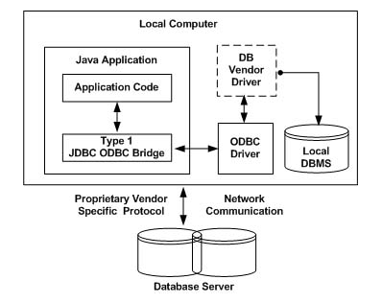
Type 1 JDBC-ODBC Bridge Driver

Slide 37
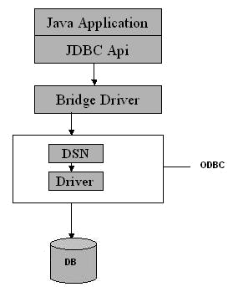
JDBC-ODBC Bridge driver

Slide 38
Type 1 JDBC-ODBC Bridge Driver
The JDBC-ODBC bridge that comes with JDK 1.2 is a good example of this kind of driver.

Slide 39
Type 2 Native-API + Java Driver
It converts JDBC call into database-specific native call i.e. this driver is specific to a particular database.
In a Type 2 driver, JDBC API calls are converted into native C/C++ API calls which are unique to the database. These drivers typically provided by the database vendors and used in the same manner as the JDBC-ODBC Bridge, the vendor-specific driver must be installed on each client machine.

Slide 40
Type 2 Native-API + Java Driver
If we change the Database we have to change the native API as it is specific to a database and they are mostly obsolete now but you may realize some speed increase with a Type 2 driver, because it eliminates ODBC's overhead.

Slide 41
Type 2 Native-API + Java Driver
Adv:
Helps in accessing the data faster as compared to others
Disadv:
Requires client-side code to be installed, hence not used for the web. Mostly obsolete now

Slide 42
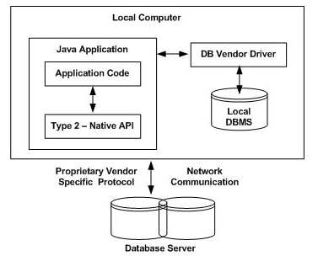
Type 2 Native-API + Java Driver

Slide 43
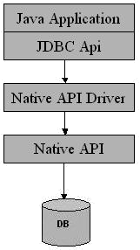
Native-API + Java Driver

Slide 44
Type 2 Native-API + Java Driver
The Oracle Call Interface (OCI) driver is an example of a Type 2 driver.

Slide 45
Type 3 JDBC-Middleware Driver
Type 3 database requests are passed through the network to middleware server that translates Java code into native API DBMS calls.
In a Type 3 driver, a three-tier approach is used to accessing databases.
The JDBC clients use standard network sockets to communicate with an middleware application server.
The socket information is then translated by the middleware application server into the call format required by the DBMS, and forwarded to the database server.

Slide 46
Type 3 JDBC-Middleware Driver
This kind of driver is extremely flexible, since it requires no code installed on the client and a single driver can actually provide access to multiple databases

Slide 47
Type 3 JDBC-Middleware Driver
Adv:
Pure java driver and hence auto downloadable
This driver is server-based, No client code need to be installed. It is suitable for the web.
Disadv:
Costlier than others

Slide 48
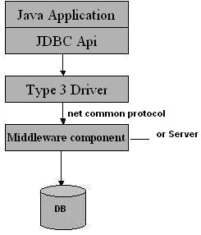
JDBC-Middleware Pure Java Driver

Slide 49
Type 4 Pure Java Driver
The Type 4 uses java networking libraries to communicate directly with the database server.
It translates JDBC calls into Database specific network calls
In a Type 4 driver, a pure Java-based driver that communicates directly with vendor's database through socket connection. This is the highest performance driver available for the database and is usually provided by the vendor itself.

Slide 50
Type 4 Pure Java Driver
This kind of driver is extremely flexible, you don't need to install special software on the client or server. Further, these drivers can be downloaded dynamically.

Slide 51
Type 4 Pure Java Driver
The Type 4 uses java networking libraries to communicate directly with the database server.
It translates JDBC calls into Database specific network calls
Adv:
Pure java driver, hence auto downloadable
No client code need be installed. It is most suitable for the web.
Does not require a middleware server
Disadv:
It uses database specific proprietary protocol and is DBMs vendor dependent

Slide 52
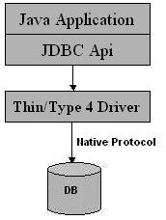
Pure Java Drivers

Slide 53
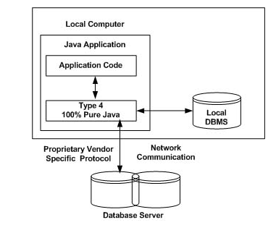
Pure Java Drivers

Slide 54
Pure Java Drivers
MySQL's Connector/J driver is a Type 4 driver. Because of the proprietary nature of their network protocols, database vendors usually supply type 4 drivers.

Slide 55
PreparedStatement
Suppose that you are going to insert 1000 records into a database.
Using Statement object ,you need to prepare 1000 different SQL INSERT strings as argument to stmt.executUpdate(sqlStr).
Running a thousand SQL INSERT is inefficient.

Slide 56
PreparedStatement
JDBC provides a class called PreparedStatement, which allows you to pass parameters to SQL statement and execute the same SQL statement multiple times.
A PreparedStatement is a pre-compiled SQL statement that is more efficient than calling the same Statement over and over.

Slide 57
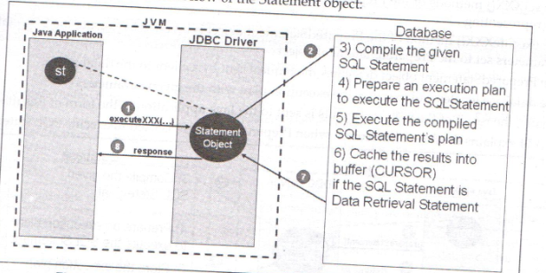
Statement object

Slide 58
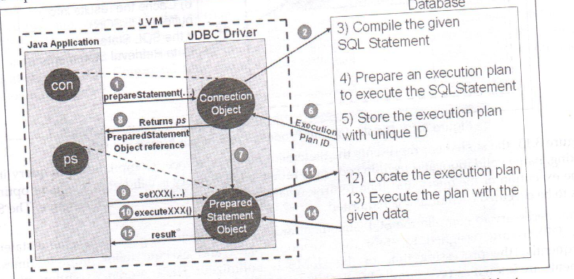
PreparedStatement

Slide 59
PreparedStatement
In PreparedStatement, “?” indicates a place holder for parameter.
A set of setxxx() methods can be used to fill in the parameters.
For ex:

Slide 60
PreparedStatement
Connection conn = DriverManager.getConnection(.......);
PreparedStatement pstmt = conn.prepareStatement(
"insert into books values (?, ?, ?)");
pstmt.setInt(1, 4001);
pstmt.setString(2, "Web Programming");
pstmt.setString(3, "Kumar");
int rowAffected = pstmt.executeUpdate();
pstmt.setInt(1, 4002);
pstmt.setString(2, "Fishing");
rowAffected = pstmt.executeUpdate();
pstmt.close();
conn.close();

